Slide 1



Slide 2

PROBLEM STATEMENT
Predict stock price of NSE-TATAGLOBAL
Build different types of model and analyze
which one is best model among those

Slide 3
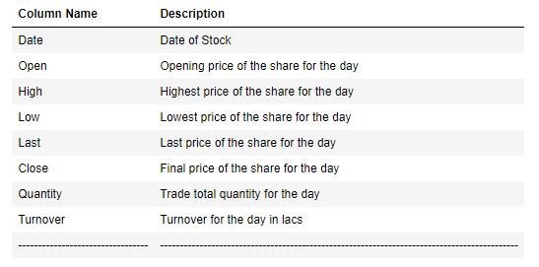
DATASET FEATURES
NSE-TATAGLOBAL - Dataset has total 1235 rows and 8 columns
Total Number of 1824 days Data
Minimum Date: 08-Sep-2015 and Maximum Date: 05-Sep-2020

Slide 4
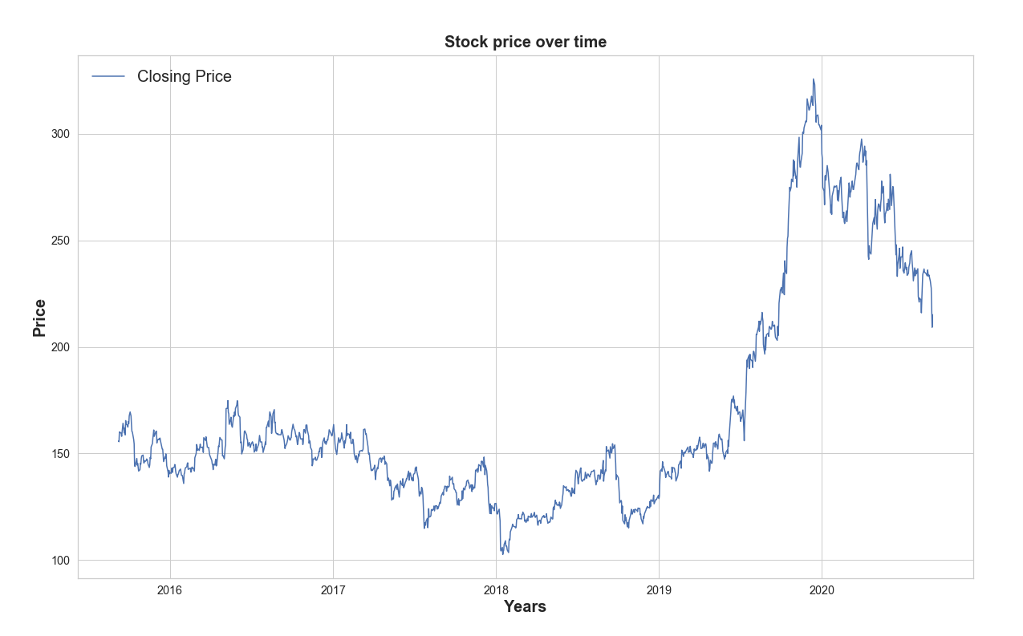
Trading History

Slide 5
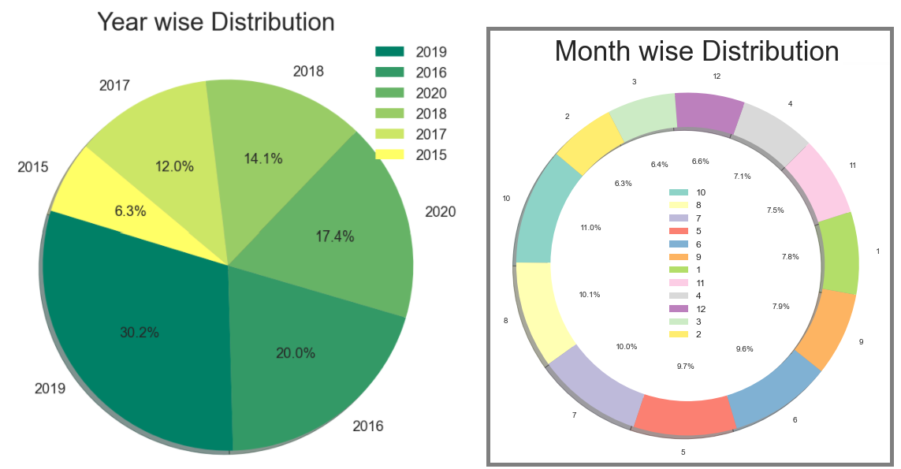
Trading Year wise and Month wise

Slide 6
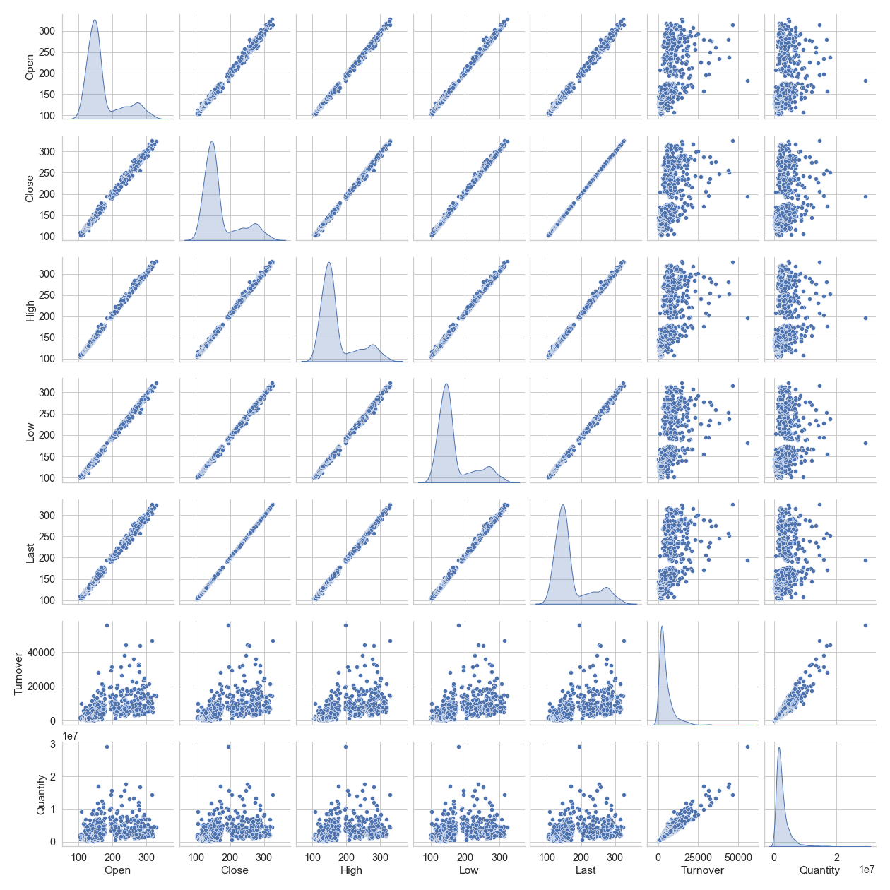
Relation Between Data

Slide 7
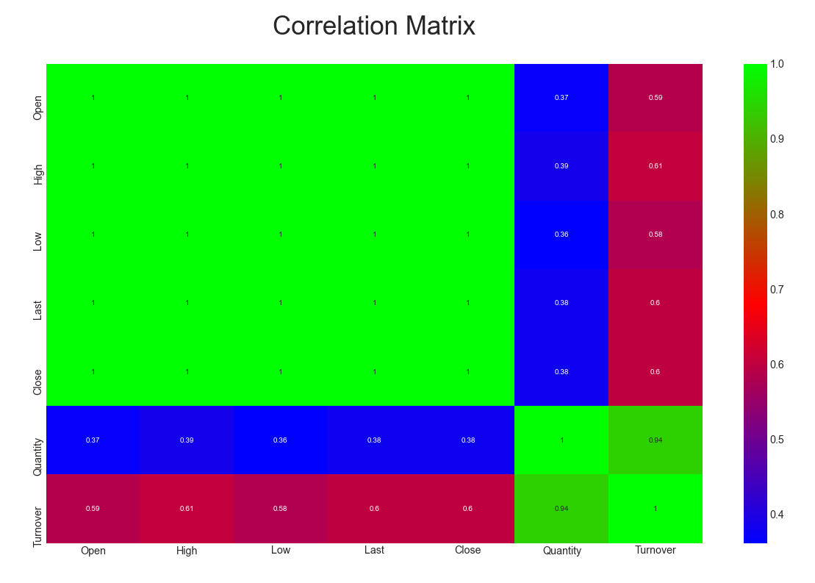
Correlations can vary from -1 to +1. Closer to +1 means strong positive correlation and close -1 means strong negative correlation. Closer to 0 means not very strongly correlated. Variables with strong correlations are mostly probable candidates for model building.
There is a no negative correlation present and data also are highly correlated.

Slide 8
ASSUMPTIONS
As we can see data are highly correlated
As per problem statement our Target Variable is ‘Close’
(closing final price) so this is a regression problem
Performed data cleanup but dataset was very nice with sufficient data
No outlier and no null values are found

Slide 9
MODELS
Used 3 different types of models for prediction
Linear Regression
ARIMA
Time Series

Slide 10
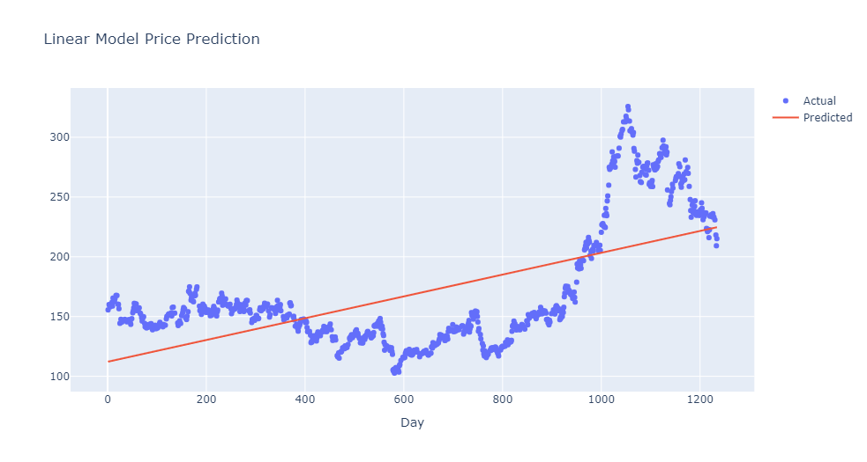

LINEAR REGRESSION

Slide 11
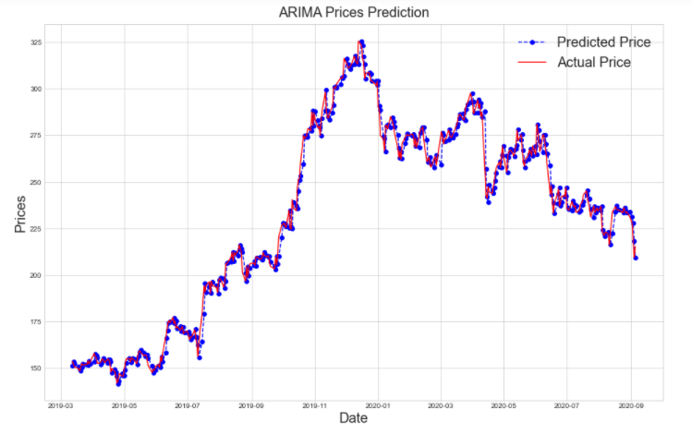
ARIMA
Testing MSE is 27.7048 which is very good score

Slide 12
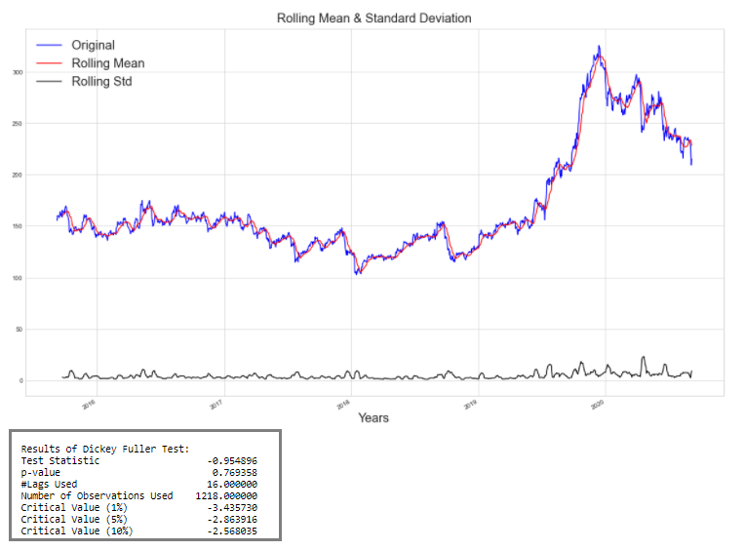
Time Series
As in both time series testing methods
Rolling and ADF showing
Given dataset not stationary.

Slide 13
CONCLUSION
The dataset taken of NSE-TATAGLOBAL from internet.
The historical data from the year 2015 to 2020 were considered for analysis.
Used Linear Regression, ARIMA and Time Series to trained and predicted the stock prices on the test dataset
Among all 3 models, ARIMA predict price with very less errors so we can say ARIMA model prediction is good.

Slide 14
THANK YOU!
By: Kaushik Rathod
Batch: Mar - 2020

